Slide 1
Lecture 8. Sorting (1)
Instructor: 黄群
huangqun@pku.edu.cn
School of Computer Science
Peking University

Slide 2
Outline
Basic Concepts
Comparison-based Methods: iterative style
Comparison-based Methods: divide-and-conquer style

Slide 3
Why Sorting?
Sorting: the process of rearranging data in either ascending or descending order
We need sorting because
The data in sorted order is required
We need to perform binary search or index a database
It is the initialization step of many algorithms.

Slide 4
Sorting in Practice
Various rankings
University rankings
Supercomputing Top500
The World’s Billionaires by Forbes
Windows file explore
…

Slide 5
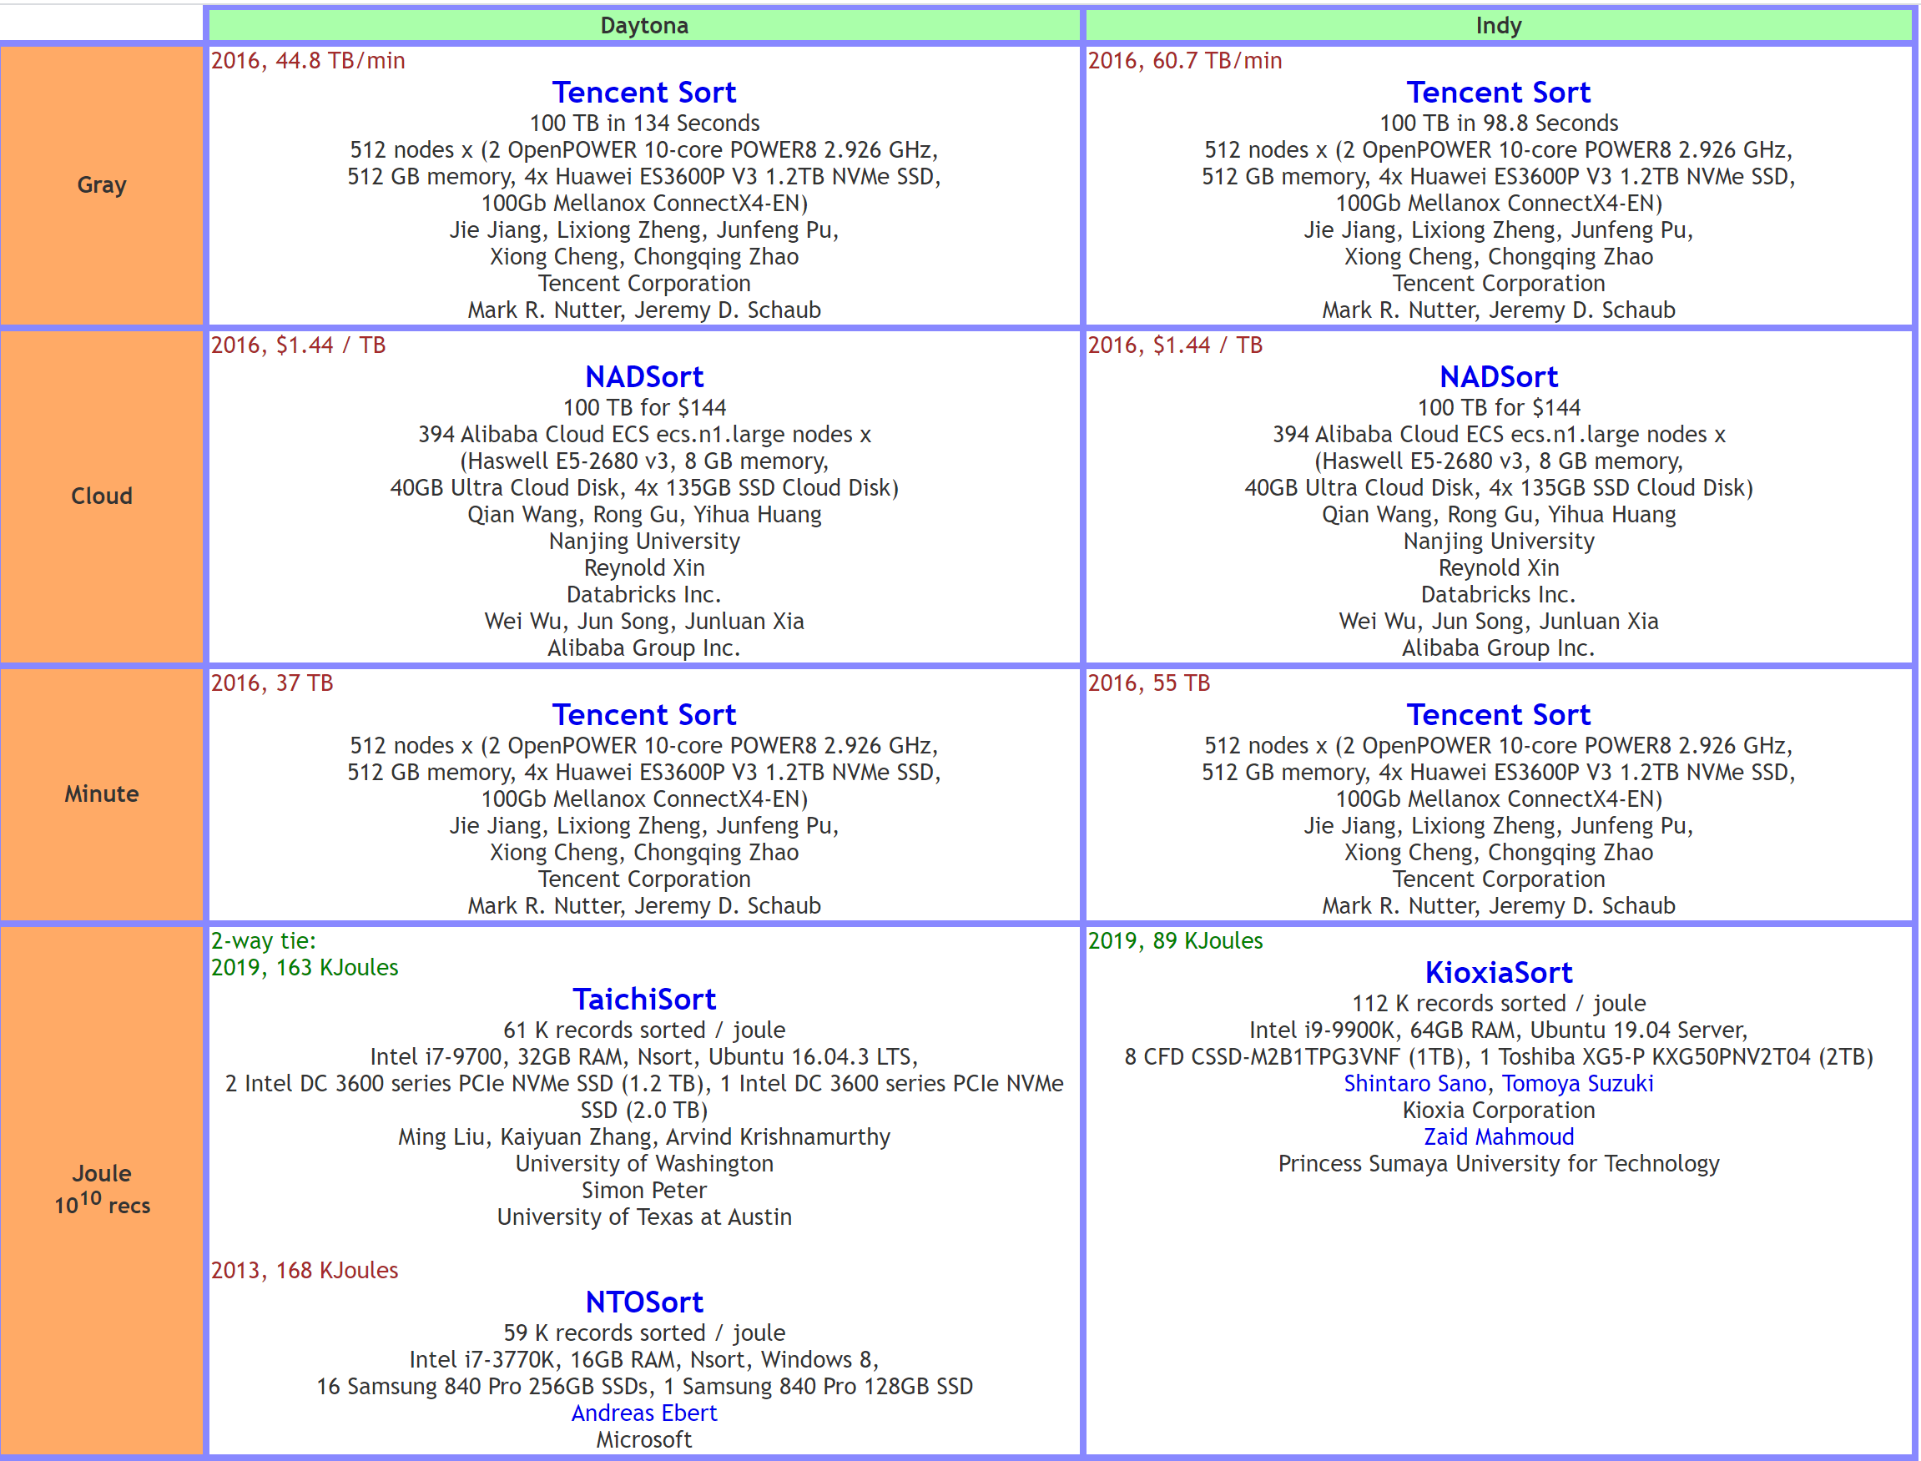
Sorting Competitions
http://sortbenchmark.org

Slide 6
Small Scale Sorting
One element
already sorted
Two elements
One comparison
If not sorted?
swap x1 = move x3 (assignments)
n elements?
45
45
34

Slide 7
Preliminary
Record
The basic unit in sorting
Key
One or more fields that distinguish one record from another
Sort key
One or more fields to be compared in sorting
Sequence
A sequential list of records

Slide 8
Sorting Problem
Given a sequence R = {r₁, r₂, …, r_{n}}
Their sort keys are k = {k₁, k₂, …, k_{n}}
The purpose of sorting: rearrange the records according to their sort keys
The new sequence R’ = {r_{s1}, r_{s2}, …, r_{sn}}
Corresponding sort keys k’ = {k_{s1}, k_{s2}, …, k_{sn}}
The order of the sort keys
k_{s1} ≤ k_{s2} ≤ … ≤ k_{sn} (non-decreasing order)
or k_{s1} ≥ k_{s1} ≥ … ≥ k_{sn} (non-increasing order)

Slide 9
Order vs. Reverse Order
In order
The resulting sequence satisfies the required order
In a reverse order
The resulting sequence satisfies the required order after we reverse the sequence
For example, for a non-increasing order
08, 12, 34, 96 (in order)
96, 34, 12, 08 (in a reverse order)

Slide 10
Stability
Stability
Some records may have the same key
The relative order of these records remain the same after sorting
Example 1: stable
34 12 34’ 08 96
08 12 34 34’ 96

Slide 11
Stability
Stability
Some records may have the same key
The relative order of these records remain the same after sorting
Example 2: unstable
34 12 34’ 08 96
08 12 34’ 34 96

Slide 12
Metrics of Sorting Algorithms
Time cost
The number of comparisons and data movement
Space cost
Implementation
How difficult to implement it?

Slide 13
Outline
Basic Concepts
Comparison-based Methods: iterative style
Insertion Sort
Bubble Sort
Selection Sort
Heap Sort
Shell Sort
Comparison-based Methods: divide-and-conquer style

Slide 14

Insertion Sort

Slide 15
Insertion Sort
N - 1 passes (for P = 1 to N - 1)
In pass P, given that A [0] to A [P-1] have been sorted, determine where to insert A [P].

Slide 16
Example
45
34
78
12
34’
32
29
64

Slide 17
Sample Code
template <class Record>
void ImprovedInsertSort (Record Array[], int n){
Record TempRecord;
for (int i=1; i<n; i++){
TempRecord = Array[i];
int j = i-1; // search for a correct position
while ((j>=0) && (TempRecord < Array[j])){ // move larger records
Array[j+1] = Array[j];
j = j - 1;
}
// Insert
Array[j+1] = TempRecord;
}
}

Slide 18
Analysis for Insertion Sort
Stable sorting
Space complexity: Θ(1)
Time complexity
Best case Θ(N): (n-1) comparisons, no moves
Worst case Θ(N²): n(n-1)/2 comparisons, n(n-1)/2 moves
The Upper Bound
When input list is in reverse order, this tight bound is achieved.
Average case: Θ(N²)

Slide 19
Outline
Basic Concepts
Comparison-based Methods: iterative style
Insertion Sort
Bubble Sort
Selection Sort
Heap Sort
Shell Sort
Comparison-based Methods: divide-and-conquer style

Slide 20
Bubble Sort
Key idea:
Repeatedly examine neighboring records
“Bubble” the smaller values upward to the front of the array
N - 1 passes, in each pass:
Compare all neighboring pairs
If a pair is in order, we leave it as it is
Otherwise, we swap the values
Terminate early: when no pairs are swapped in a pass

Slide 21
Example
45
34
78
12
34’
32
29
64

Slide 22
Sample Code
template <class Record>
void BubbleSort(Record Array[], int n) {
bool NoSwap; // whether swaps occur
int i, j;
for (i = 0; i < n-1; i++) {
NoSwap = true;
for (j = n-1; j > i; j--){
if (Array[j] < Array[j-1]) {
swap(Array, j, j-1); // Swap
NoSwap = false
}
}
if (NoSwap) // No swap: return
return;
}
}

Slide 23
Analysis for Bubble Sort
Stable
Space cost: Θ(1)
Time cost
Comparisons
Best case: Θ(n)
Worst case: Θ(n²)
Swapping:
Best case: 0
Worst case: Θ(n²)
Average: Θ(n²)
Overall
Worst case, average case: Θ(n²)
Best case: Θ(n)

Slide 24
Outline
Basic Concepts
Comparison-based Methods: iterative style
Insertion Sort
Bubble Sort
Selection Sort
Heap Sort
Shell Sort
Comparison-based Methods: divide-and-conquer style

Slide 25
Selection Sort
Key idea
For each position in the list, selects the right record that should go in that position
If we have selected records for position 0, 1…P-1
Then for position P, we just need to select the minimum among the rest records

Slide 26
Example
45
34
78
12
34’
32
29
64

Slide 27
Sample Code
template <class Record>
void SelectSort(Record Array[], int n) {
for (int i=0; i<n-1; i++) { // select record for position i
int Smallest = i;
for (int j=i+1;j<n; j++) // search among the remaining records
if (Array[j] < Array[Smallest])
Smallest = j; // record the smallest
// put the corrently smallest record in position i
swap(Array, i, Smallest);
}
}

Slide 28
Analysis for Selection Sort
Unstable
Space cost: Θ(1)
Time cost:
Comparisons: Θ(n²)
Swaps: Θ(n)
Overall: Θ(n²)

Slide 29
Outline
Basic Concepts
Comparison-based Methods: iterative style
Insertion Sort
Bubble Sort
Selection Sort
Heap Sort
Shell Sort
Comparison-based Methods: divide-and-conquer style

Slide 30
Heap Sort
Optimize Selection Sort
Use a Min-Heap to select smallest record?
Heap Sort: use a Max-Heap
Each time remove the largest element
Recall that a heap is implemented as an array
The removed record can be seamlessly placed at the end of the array

Slide 31
Example
78
34
45
12
29
34’
32

Slide 32
Example
32
34
45
12
29
34’
78

Slide 33
Sample Code
template <class Record>
void sort(Record Array[], int n){
int i;
MaxHeap<Record> max_heap = MaxHeap<Record>(Array,n,n); // Build heap
for (i = 0; i < n-1; i++)
// The removed largest record is swapped to the end of the array
max_heap.RemoveMax();
}

Slide 34
Analysis for Heap Sort
Space complexity: Θ(1)
Time complexity
Build heap: Θ(n)
Remove n times: Θ(nlogn)
Overall: Θ(nlogn)

Slide 35
Outline
Basic Concepts
Comparison-based Methods: iterative style
Insertion Sort
Bubble Sort
Selection Sort
Heap Sort
Shell Sort
Comparison-based Methods: divide-and-conquer style

Slide 36
Shell Sort
Motivation: 2 good properties of Insertion Sort
Time complexity of best case: Θ(n)
Easy for short array
Shell Sort: leverage the two good properties of Insertion Sort

Slide 37
Shell Sort
Split the array into some sub-arrays
Insertion Sort for each sub-array
Increase the size of sub-arrays
Decrease the number
Finish: process the whole array

Slide 38
Shell Sort
Question: how to create sub-arrays
Sub-array size increases, but
Sub-array number decreases
Spaced records form sub-arrays, with Δ
Sub-array 1: x₀, x_{Δ}, x_{2Δ}…
Sub-array 2: x₁, x_{1+Δ}, x_{1+2Δ}…
Sub-array 3: x₂, x_{2+Δ}, x_{2+2Δ}…
Start with a large Δ, halve it after sorting all sub-arrays
Optimize it later

Slide 39
Example
32
29
34’
12
34’
32
29
12
45
34
78
64
45
34
78
12
45
34’
32
34
78
29
64
34’
32
29
12
45
34
78
64
34’
32
78
12
45
34
29
64
64

Slide 40
Sample Code
template <class Record>
void ShellSort(Record Array[], int n) {
for (int delta = n/2; delta>0; delta /= 2) // halve delta each time
for (int i = 0; i < delta; i++)
// Call Insertion Sort for array staring i
ModInsSort(&Array[i], n-i, delta); //
// If the last delta is not 1
// ModInsSort(Array, n, 1);
}

Slide 41
Sample Code
template <class Record>
void ModInsSort(Record Array[], int n, int delta) {
for (int i = delta; i < n; i += delta) // For i-th element
for (int j = i; j >= delta; j -= delta) { // Find its position
if (Array[j] < Array[j-delta])
swap(Array, j, j-delta);
else break;
}
}

Slide 42
Analysis for Shell Sort
Unstable
Space cost: Θ(1)
Time cost: Θ(n²)
It seems that good increments can reduce it
But what about bad increments?

Slide 43
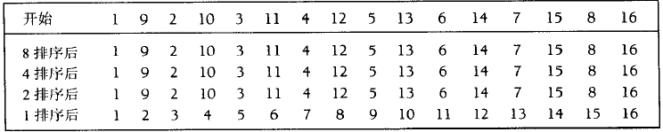
Analysis for Shell Sort
Worst case Θ(N²) with current 2^{k} increments
construct a bad case to prove
show the upper bound by summing up the costs in all passes
start
after 8-sort
after 4-sort
after 2-sort
after 1-sort

Slide 44
Intuition
Problem: redundant comparisons
Example: x₀ and x₈ are compared when Δ=8, Δ=4, Δ=2, Δ=1
Root cause: increments are not co-prime
the subsequence with increment 2^{k-1} is composed of those with an increment of 2^{k}
lead to redundant comparisons
Solution: reduce redundancy
Co-prime increments
Non-overlapping subsequences

Slide 45
More Increments
Hibbard’s increment
{2^{k} -1，2^{k-1} -1，…，7，3，1}
Worst-case running time Θ (N ^{3/2})
Average-case running time Θ (N ^{5/4})
Sedgewicks increment
{1, 5, 19, 41, 109, ...}
Each term is either 9*4^{i}-9*2^{i}+1 or 4^{i}-3*2^{i}+1
worst-case running time Θ (N ^{4/3}), average Θ (N ^{7/6})
Best increments:
{1, 2, 3, 4, 6, 8, 9, 12}
Each term is 2^{p}3^{q}
Θ(n log₂n)

Slide 46
Outline
Basic Concepts
Comparison-based Methods: iterative style
Comparison-based Methods: divide-and-conquer style

Slide 47
Divide-And-Conqure
Key idea
Split a problem into (non-overlap) sub-problems
Recursively solve each sub-problem
Merge results of sub-problems
Example
BST operations
Merge Sort, Quick Sort
Binary Search

Slide 48
Outline
Basic Concepts
Comparison-based Methods: iterative style
Comparison-based Methods: divide-and-conquer style
Merge Sort
Quick Sort

Slide 49
Merge Sort
Motivation
Merging of 2 sorted lists can be done in O(N) time.
One pass through the input, if the output is put in a third list.
Using a divide and conquer approach (recursion)
Divide a list into 2 sub-lists
Recursively call Merge Sort on each sub-list
Merge the 2 sorted sub-lists

Slide 50
Example
24 13 26 1 2 27 38 15
1 2 13 15 24 26 27 38
MSort
Merge
24 13 26 1 2 27 38 15
1 13 24 26 2 15 27 38
MSort
MSort
Merge
Merge
24 13 26 1 2 27 38 15
13 24 1 26 2 27 15 38
MSort
MSort
MSort
MSort
Merge
Merge
Merge
Merge
24 13 26 1 2 27 38 15

Slide 51
Sample Code
// Array is the list to be sorted, left and right are boundaries of the list
template <class Record>
void MergeSort(Record Array[], Record TempArray[], int left, int right) {
// if there are zero or one element left, do not need to sort
if (left < right) {
int middle = (left + right) / 2; // Split the list equally
MergeSort(Array,TempArray,left,middle); // Sort the left half
MergeSort(Array, TempArray,middle+1,right); // Sort the right half
Merge(Array, TempArray,left,right,middle); // Merge
}
}

Slide 52
Question: How to Merge
Key idea: utilize the sorted results of the two sub-lists
Approach
Scan the two sub-lists (from small to large)
Add the smaller element one by one

Slide 53
Sample Code: Merge
template <class Record>
void Merge(Record Array[], Record TempArray[], int left, int right, int middle) {
for (int j = left; j <= right; j++) // Store current list into a temp one
TempArray[j] = Array[j];
int index1 = left; // index of 1st sub-list
int index2 = middle+1; // index of 2nd sub-list
int i = left; // index of merged list
while (index1 <= middle && index2 <= right) {
// select the smaller one
if (TempArray[index1] <= TempArray[index2])
Array[i++] = TempArray[index1++];
else Array[i++] = TempArray[index2++];
}
while (index1 <= middle) // Remaining elements in 1st sub-list
Array[i++] = TempArray[index1++];
while (index2 <= right) // Remaining elements in 2nd sub-list
Array[i++] = TempArray[index2++];
}

Slide 54
Optimization
Problem
Complicated boundary conditions
Optimization
One sub-list with normal order
The other with reverse order
Merge from two ends to the middle

Slide 55
Optimization: Example
(25 34 45 32 78 12 34’ 64)
(25 34 45 32)(78 12 34’ 64)
Split
(25 34)(45 32)(78 12)(34’ 64)
(25)(34)(45)(32)(78)(12)(34’)(64)
(25 34)(45 32)(12 78)(64 34’)
Merge
(25 32 34 45)(78 64 34’ 12 )
(12 25 32 34 34’ 45 64 78)

Slide 56
Optimization: Implementation
Don’t need to implement two versions of Merge
Recall that we will copy sub-lists into a temp list
Just reverse the 2nd sub-list during the copy

Slide 57
Optimization: Sample Code
template <class Record> void ModMerge(Record Array[], Record TempArray[], int left,int right,int middle) {
int index1, index2, k; // indexes for two sub-lists, and final array
for (int i = left; i <= middle; i++)
TempArray[i] = Array[i]; // Copy 1st sub-list
for (int j = 1; j <= right-middle; j++) // Copy 2nd sub-list in reverse order
TempArray[right-j+1] = Array[j+middle];
for (index1=left, index2=right, k=left; k<=right; k++)
if (TempArray[index1] <= TempArray[index2])
Array[k] = TempArray[index1++];
else
Array[k] = TempArray[index2--];
}

Slide 58
Optimization: How It Works
k
k
34
45
32
78
34’
12
34’
78
25
12
64
64
i1
i2
i1
i2

Slide 59
Analysis
Space complexity: Θ(n)
Time complexity: T(n)
Since T(1) = 1, we have T(n) = Θ(nlog n)
T(n) = Θ(nlog n) for best-case, average-case and worst-case
Do not depend on input

Slide 60
Further Optimization
Motivation: recursion is expensive for short list
Optimization:
Use other sorting algorithms for small list

Slide 61
Example: Optimized Merge Sort
template <class Record>
void ModMergeSort(Record Array[], Record TempArray[], int left, int right) {
int middle;
if (right-left+1 > THRESHOLD) { // Long list: merge sort
middle = (left + right) / 2;
ModMergeSort(Array, TempArray ,left,middle);
ModMergeSort(Array, TempArray ,middle+1,right);
ModMerge(Array, TempArray ,left,right,middle);
}
else InsertSort(&Array[left],right-left+1); // Short list: insert sort
}

Slide 62
More Questions
Is MergeSort stable?
How about MergeSort with Optimization?

Slide 63
Outline
Basic Concepts
Comparison-based Methods: iterative style
Comparison-based Methods: divide-and-conquer style
Merge Sort
Quick Sort

Slide 64

Quicksort: An Overview
Fastest known (internal) sorting algorithm in practice
Average performance is O (N log N)
Worst case performance is O (N²)
By Tony Hoare in 1962
(1934 – now, Turing Award 1980)

Slide 65
Top Ten Algorithms in the 20th Century
Dongarra, Sullivan, “Guest Editors Introduction to the top 10 algorithms,” Computing in Science and Engineering, 2000.
Metropolis Algorithm for Monte Carlo
Simplex Method for Linear Programming
Krylov Subspace Iteration Methods
The Decompositional Approach to Matrix Computations
The Fortran Optimizing Compiler
QR Algorithm for Computing Eigenvalues
Quicksort Algorithm for Sorting
Fast Fourier Transform
Integer Relation Detection
Fast Multipole Method
What will be the top ten algorithms in this century?

Slide 66
Basic Idea
Algorithm
If the number of elements in S is 0 or 1, return.
Pick any element v
This is called the pivot (轴值)
Partition S-{v} (the remaining elements in S) into two disjoint groups:
S₁ = {x ∈ S-{v} | x ≤ v}, and
S₂ = {x ∈ S-{v} | x ≥ v}.
Return {quicksort (S₁) + v + quicksort (S₂)}.

Slide 67
Example
25 34 45 32 34’12 29 64
25 29 12
32
34’64 45 34
12 25
29
34’34 45
64
12
25
34’
34
45
Final Results：12 25 29 32 34’ 34 45 64

Slide 68
Sample Code
template <class Record>
void QuickSort(Record Array[], int left, int right) {
if (right <= left) // only 0 or 1 elements
return;
int pivot = SelectPivot(left, right);
pivot = Partition(Array, left, right);
QuickSort(Array, left, pivot-1); // Quick Sort for 1st sub-list
QuickSort(Array, pivot +1, right); // Quick Sort for 2nd sub-list
}

Slide 69
Key Questions
How to select the pivot?
better to create even sub-lists
Given a pivot, how to partition the elements?

Slide 70
Different Pivot Selection Strategies
How to select the pivot?
Choice #1: use the first element
Choice #2: randomly choose
Choice #3: median-of-three
Left, Right, and Center

Slide 71
Key Questions
How to select the pivot?
Given a pivot, how to partition the elements?

Slide 72
Partitioning Method 1
25
34
34
45
45
32
32
34’
12
12
29
29
64
64
i
j
Step 1: Store the pivot element
Step 2: Move last element to pivot’s position
Step 3: Initialize i to the 1st element, j to the last element
Repeat
Step 4: increment i until an element larger than pivot
Move this element to j-th position
Step 5: decrement j until an element smaller than pivot
Move this element to i-th position
Repeat until i==j

Slide 73
Method 1: Sample Code
template <class Record>
int Partition(Record Array[], int left, int right, int pivot) {
Record TempRecord = Array[pivot]; // Save pivot value
Swap(Array, pivot, right)
int l = left;
int r = right;
while (l != r) {
// increment l
while (Array[l] <= TempRecord && r > l)
l++;
if (l < r) {
Array[r] = Array[l]; // move a larger element to r-th position
r--;
}
// decrement r
while (Array[r] >= TempRecord && r > l)
r--;
if (l < r) { // move a smaller element to r-th position
Array[l] = Array[r];
l++;
}
} //end while
Array[l] = TempRecord; // move pivot to correct position
return l;
}

Slide 74
Partitioning Method 2
Step 1: Swap pivot with last element
Step 2: Initialize i to the 1st element, j to the last element
Step 3: Increment i until an element larger than pivot
Step 4: Decrement j until an element smaller than pivot
(We have a large element in position i and a smaller element at position j)
Step 5:
If i < j, swap the elements, and repeat Step 3
Otherwise, swap pivot with element at position i

Slide 75
Method 2: Example
Example: 8 1 4 9 6 3 5 2 7 0
Start: 8 1 4 9 0 3 5 2 7 6
i j
Move i: 8 1 4 9 0 3 5 2 7 6
i j
Move j: 8 1 4 9 0 3 5 2 7 6
i j
if smaller
if bigger

Slide 76
Method 2: Example
1st swap 2 1 4 9 0 3 5 8 7 6
i j
Move i: 2 1 4 9 0 3 5 8 7 6
i j
Move j: 2 1 4 9 0 3 5 8 7 6
i j

Slide 77
Method 2: Example
2nd swap 2 1 4 5 0 3 9 8 7 6
i j
Move i: 2 1 4 5 0 3 9 8 7 6
i meet j
Move j: 2 1 4 5 0 3 9 8 7 6
(i & j crossed) j i
Swap element at i with pivot:
2 1 4 5 0 3 6 8 7 9

Slide 78
Method 2: Sample Code
template <class Record>
int Partition(Record Array[], int left, int right, int pivot) {
Array[right] = Array[pivot]; // Save pivot value
int l = left;
int r = right - 1;
for (; ;) {
while (l<r && Array[l++] < Array[right]) {}
while (l<r && Array[r--] > Array[right]) {}
if (l < r)
Swap (Array, l, r);
else
break;
}
Swap(Array, l, right)
return l;
}

Slide 79
Analysis
Space Complexity: Depends on depth of recursive calls
Time Complexity: T(n)
T(0) = T(1) = 1
Select Pivot: constant
Partitioning: c(n)
After partitioning: two sub-lists with length i and n-i-1
Time to sort them is T(i) and T(n-i-1)

Slide 80
Worst Case
…
Finally

Slide 81
Best Case
Finally
…

Slide 82
Average Case
With equal probability, the average of T(i) and T(n-1-i) is
Then

Slide 83
Putting It Together
Worst Case:
Time: Θ(n²)
Space: Θ(n)
Best Case:
Time: Θ(nlog n)
Space: Θ(log n)
Average Case:
Time: Θ(nlog n)
Space: Θ(log n)

Slide 84
Exercise: Selection Problem
Find the kth smallest element in a random array
using a heap: O(N) + k O(log N)
Quick Select: O(N) expected time
Quick Select is also proposed by Tony Hoare

Slide 85
Why Quick Sort is Fast
QuickSort:
Average: O(n*log n)
Worst: O(n^2)
MergeSort
Average: O(n*log n)
Worst: O(n*log n)
HeapSort
Average: O(n*log n)
Worst: O(n*log n)

Slide 86
Why Quick Sort is Fast
Compared to Merge Sort
Fewer memory access
Merge Sort: >=2n reads, >=2n writes
Quick Sort: n read, <= n write
Link: sorting algorithms to relax/study to - YouTube

Slide 87
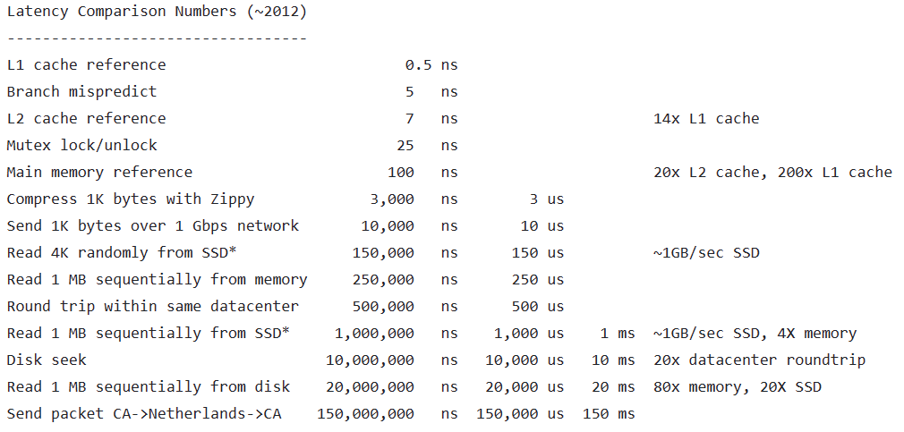
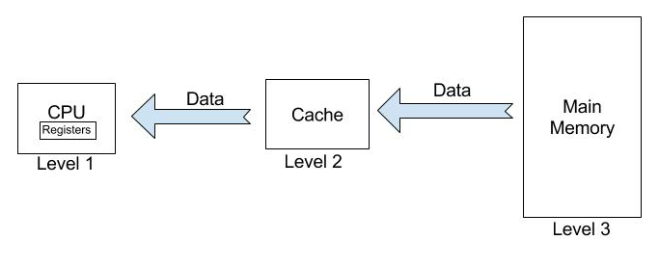
Why Quick Sort is Fast
Better Cache efficiency
Numbers Every Programmer Should Know By Year
(original idea from Jeff Dean, Google)

Slide 88
Why Quick Sort is Fast
Merge Sort: auxiliary array -> array switching
Heap Sort
Random access
long-distance element moves
Quick Sort
Single array
Linear scanning
Fewer long-distance moves

Slide 89
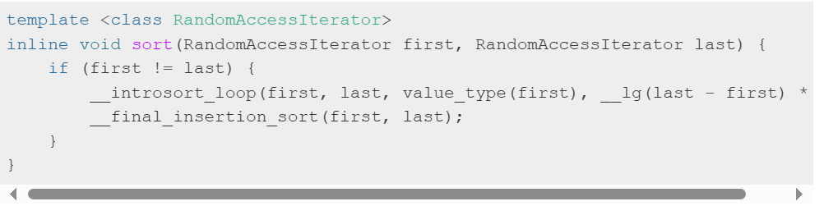
STL sort()
Introsort (introspective sort)
quicksort for long list
switch to heap sort when recursion is too deep
Avoid O(n) worst case
stop recursion when the sequence is too short
For example, when n < 16
Final insertion sort for short list
Source:《STL源码剖析》

Slide 90
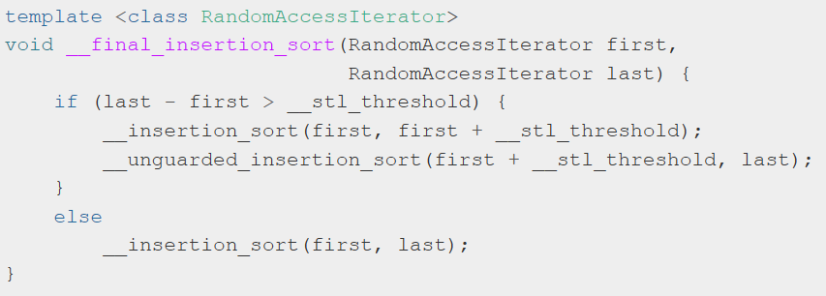
STL sort()
Final insertion sorting
insertion sort the first 16 elements
unguarded insertion sort the remaining elements
No boundary checking in unguarded version
Can it be correct?
Hint: property of Quick Sort/Heap Sort

Slide 91
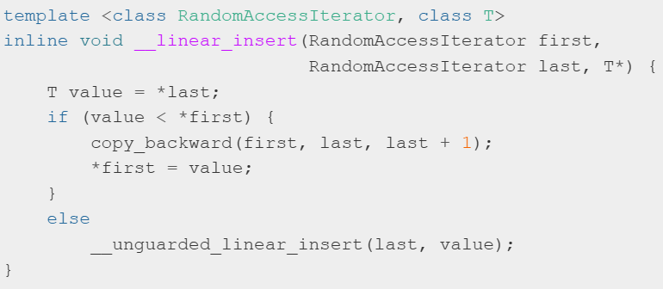
More Optimization
Inserted value < smallest (leftmost) value:
Directly copy!
Save #comparisons

Slide 92
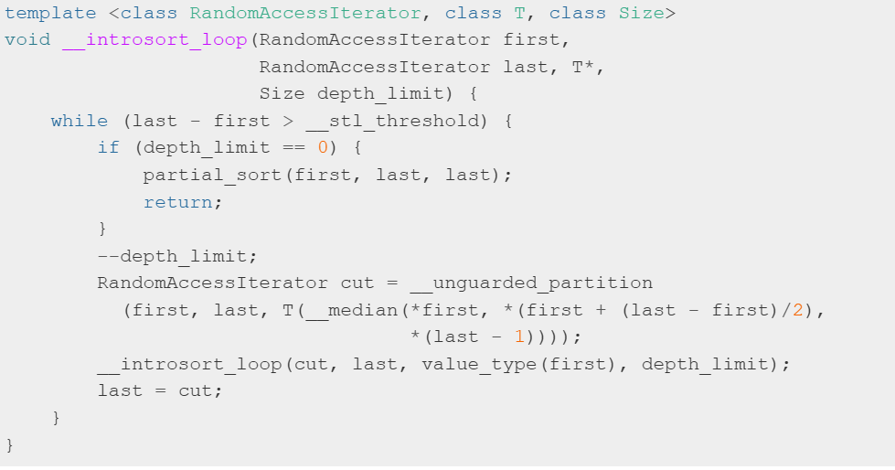
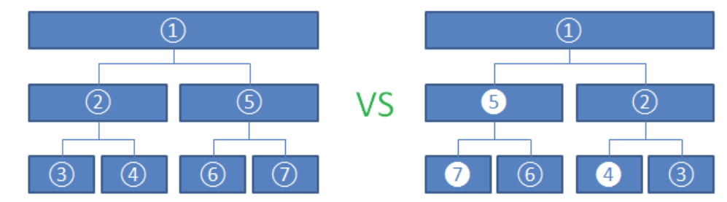
More Optimization
Only one recursive call for 2nd sub-array
Execution order
Before optimization
After optimization
Sub-arrays 4, 5, 7 are executed via loops instead of function calls
Loop for 1st sub-array

Slide 93
Runtime Cost of Comparison-Based Sorting
Simple sorting algorithms
n(n-1)/4 inversions on average
average runtime is O(n²) if only comparing neighboring elements
Bubble Sort
Insertion Sort

Slide 94
Runtime Lower Bound
Runtime lower bound of the sorting problem is between Ω(n) and O(n log n)
Ω(n): I/O time
O(n log n): for example, mergesort
Runtime lower bound of comparison-based sort is also Ω(n log n)
Comparison-based sort: only the less-than operator “<” and assignment are allowed on the input data

Slide 95
Decision Tree of Comparison Sort
A<B<C A<C<B C<A<B
B<A<C B<C<A C<B<A
A<B
B<A
A<B<C
A<C<B
C<A<B
B<A<C
B<C<A
C<B<A
A<C
C<A
B<C
C<B
A<B<C
A<C<B
C<A<B
B<A<C
B<C<A
C<B<A
B<C
C<B
A<C
C<A
A<B<C
A<C<B
B<A<C
B<C<A
Notes:
95

Slide 96
Decision Tree
The maximum depth of a leaf is the number of comparisons required in the worst case
The minimum depth of a leaf is the number of comparisons required in the best case

Slide 97
Lower Bound of Comparison Sort
n! leaves for an input length of n
Depth of the decision tree is log(n!)
log(n!) comparisons required in Ω(n log n) time
log(n!) = log(n) + log(n-1) + … + log(1)
≥ log(n) + log(n-1) + … log(n/2)
≥ n/2 log(n/2)
= Ω(n log n)
Thus, any comparison-based sorting algorithms require Ω(n log n)) comparisons
The lower bound is Ω(n log n))

Slide 98
Summary
Basic Concepts
Comparison-based Methods: iterative style
Insertion Sort
Bubble Sort
Selection Sort
Heap Sort
Shell Sort
Comparison-based Methods: divide-and-conquer style
Merge Sort
Quick Sort

Slide 99
More Questions?
Non-Comparison Algorithms?
See Answers Next Time!

